Slide 1

Data Visualization
CSC10108
Working with Time Series
TW2
Presenter: Nam Le

Slide 2
Contents
Quick introduction to Time Series: Definition, Basic concepts, Examples, and Applications.
Requirement of this assignment.
Questions & Answer.

Slide 3
Introduction
Real-world conditions are constantly changing over time, so we have the ability to assess and predict the effects of these changes in order to suggest the most appropriate actions to take.

Slide 4
Introduction
So what we need?
use appropriate forecasting techniques to support business, operations, technology, research, etc.
Good forecasts = more accurate and less biased.

Slide 5
Introduction
=> Time Series Analysis, using statistical methods, allows
enhance comprehension
and predictions
on any quantitative variable of interest (sales, resources, financial KPIs, logistics, sensors’ measurements, etc.)

Slide 6
Applications
Logistic and Transportation:
Forecasting of shipped packages: workforce planning

Slide 7
Applications
Logistic and Transportation:
Forecasting of shipped packages: workforce planning
Retail grocery:
Forecasting of sales during promotions: optimizing warehouses

Slide 8
Applications
Logistic and Transportation:
Forecasting of shipped packages: workforce planning
Retail grocery:
Forecasting of sales during promotions: optimizing warehouses
Insurance
Claims prediction: determining insurance policies

Slide 9
Applications
Manufacturing:
Predictive Maintenance: improving operational efficiency
Energy & Utilities:
Energy load forecasting: better planning and trading strategies

Slide 10
Basic concepts
A Time series is made up by dynamic data collected over time!
=> You should distinguish some types of dynamic data below :)

Slide 11
Time series data
Time series data - It is a collection of observations (behavior) for a single subject (entity) at different time intervals (generally equally spaced)

Slide 12
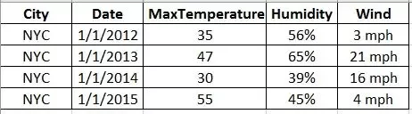
Time series data
Example: Max Temperature, Humidity and Wind (all three behaviors) in New York City (single entity) collected on First day of every year (multiple intervals of time).

Slide 13
Cross-Sectional data
Cross-Sectional data - Its is a collection of observations (behavior) for multiple subjects (entities) at single point in time.

Slide 14
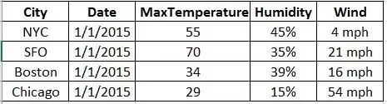
Cross-Sectional data
Example: Max Temperature, Humidity and Wind (all three behaviors) in New York City, SFO, Boston, Chicago (multiple entities) on 1/1/2015 (single instance).

Slide 15
Panel Data
Panel data = Longitudinal Data = Cross-sectional Time-series
It is a combination of above mentioned types, i.e., collection of observations for multiple subjects at multiple instances.

Slide 16
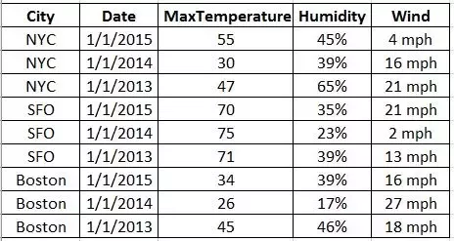
Panel Data
Example: Max Temperature, Humidity and Wind (all three behaviors) in New York City, SFO, Boston, Chicago (multiple entities) on First day of every year (multiple intervals of time).

Slide 17
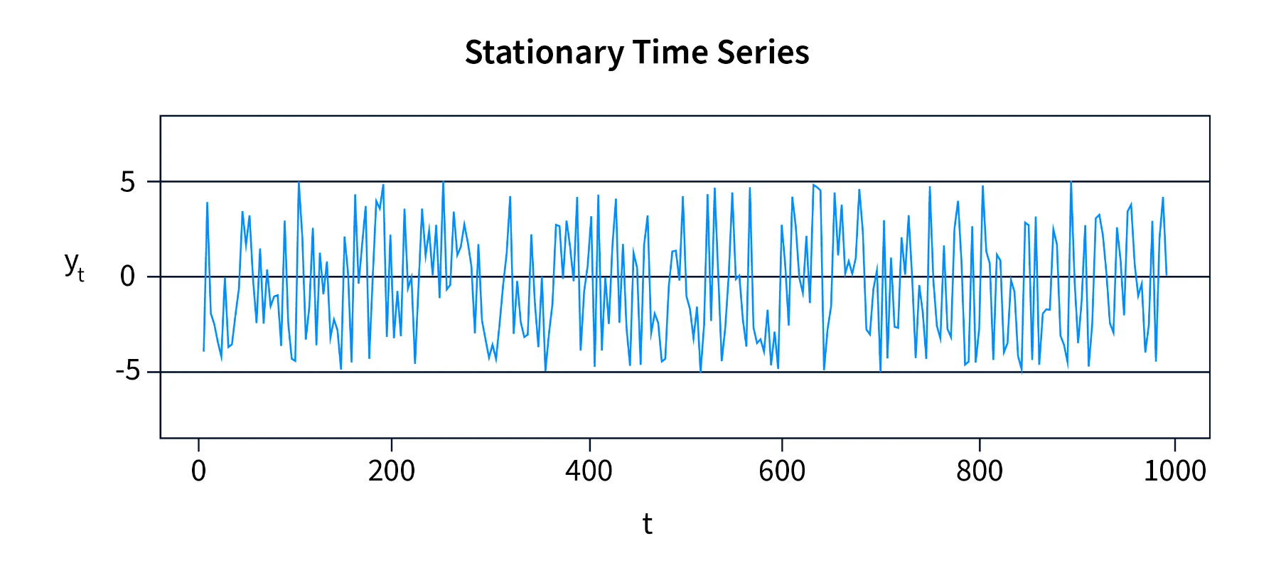
TS Properties: stationarity
Mean and variance don’t change overtime.

Slide 18
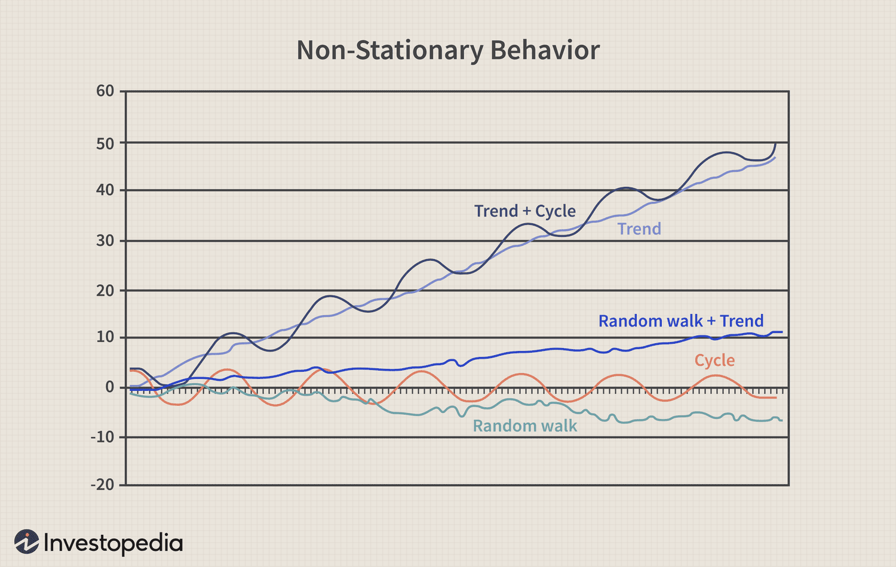
TS Properties: stationarity

Slide 19
TS Properties: periodicity
Periodicity = seasonality = repeated fluctuations over time

Slide 20
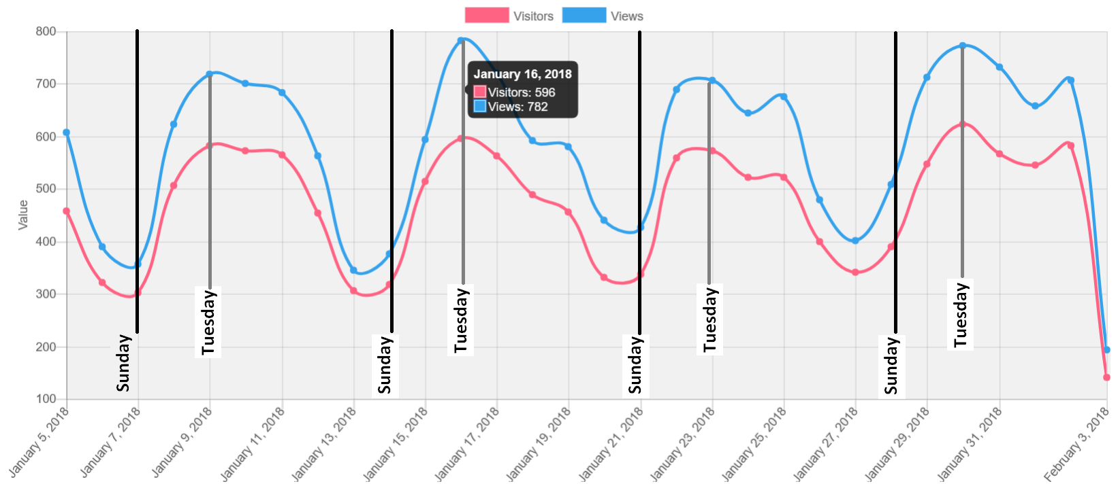
TS Properties: periodicity

Slide 21
TS Properties: autocorr
autocorrelation = the correlation of a time series with some delayed copy of itself

Slide 22
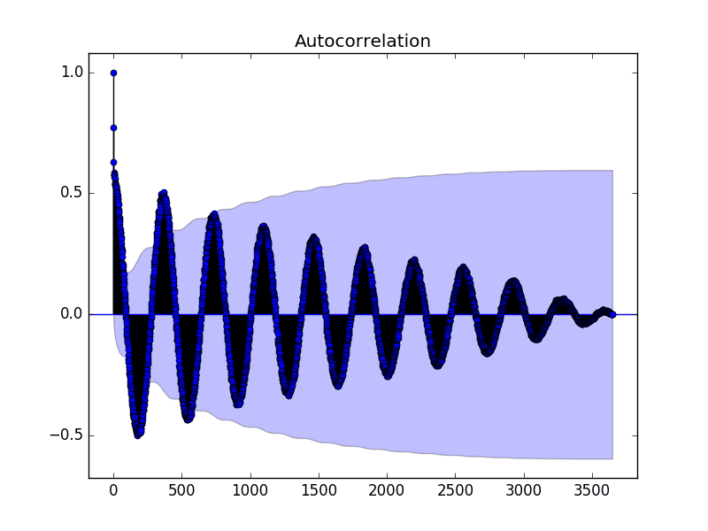
TS Properties: autocorr

Slide 23
Modelling
You can learn how to use these model
Moving average
Auto-regressive

Slide 24
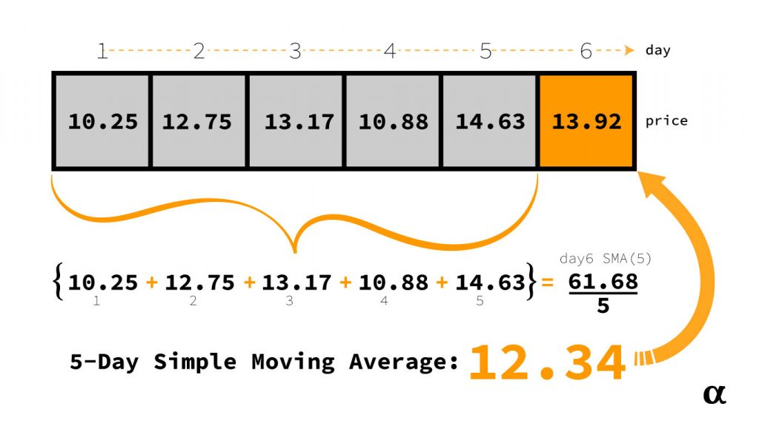
Modelling: Moving average

Slide 25
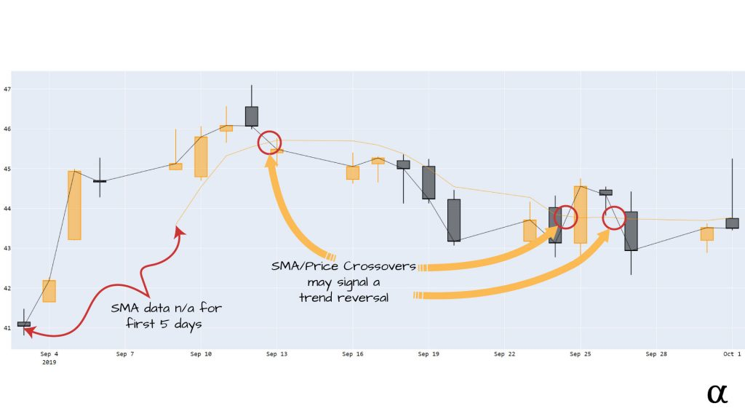
Modelling: Moving average

Slide 26
About this Assignment
:) Let’s read the document together.

Slide 27
Questions & Answers
Student asks: Can we pass this assignment easily?
Teacher answers: actually…no :D

Slide 28
References
[1] What is the difference between panel data, time-serial data, and cross-sectional data?
[2] Introduction to Time Series Analysis, KNIME
[3] alpharihms

